Slide 1


Slide 2

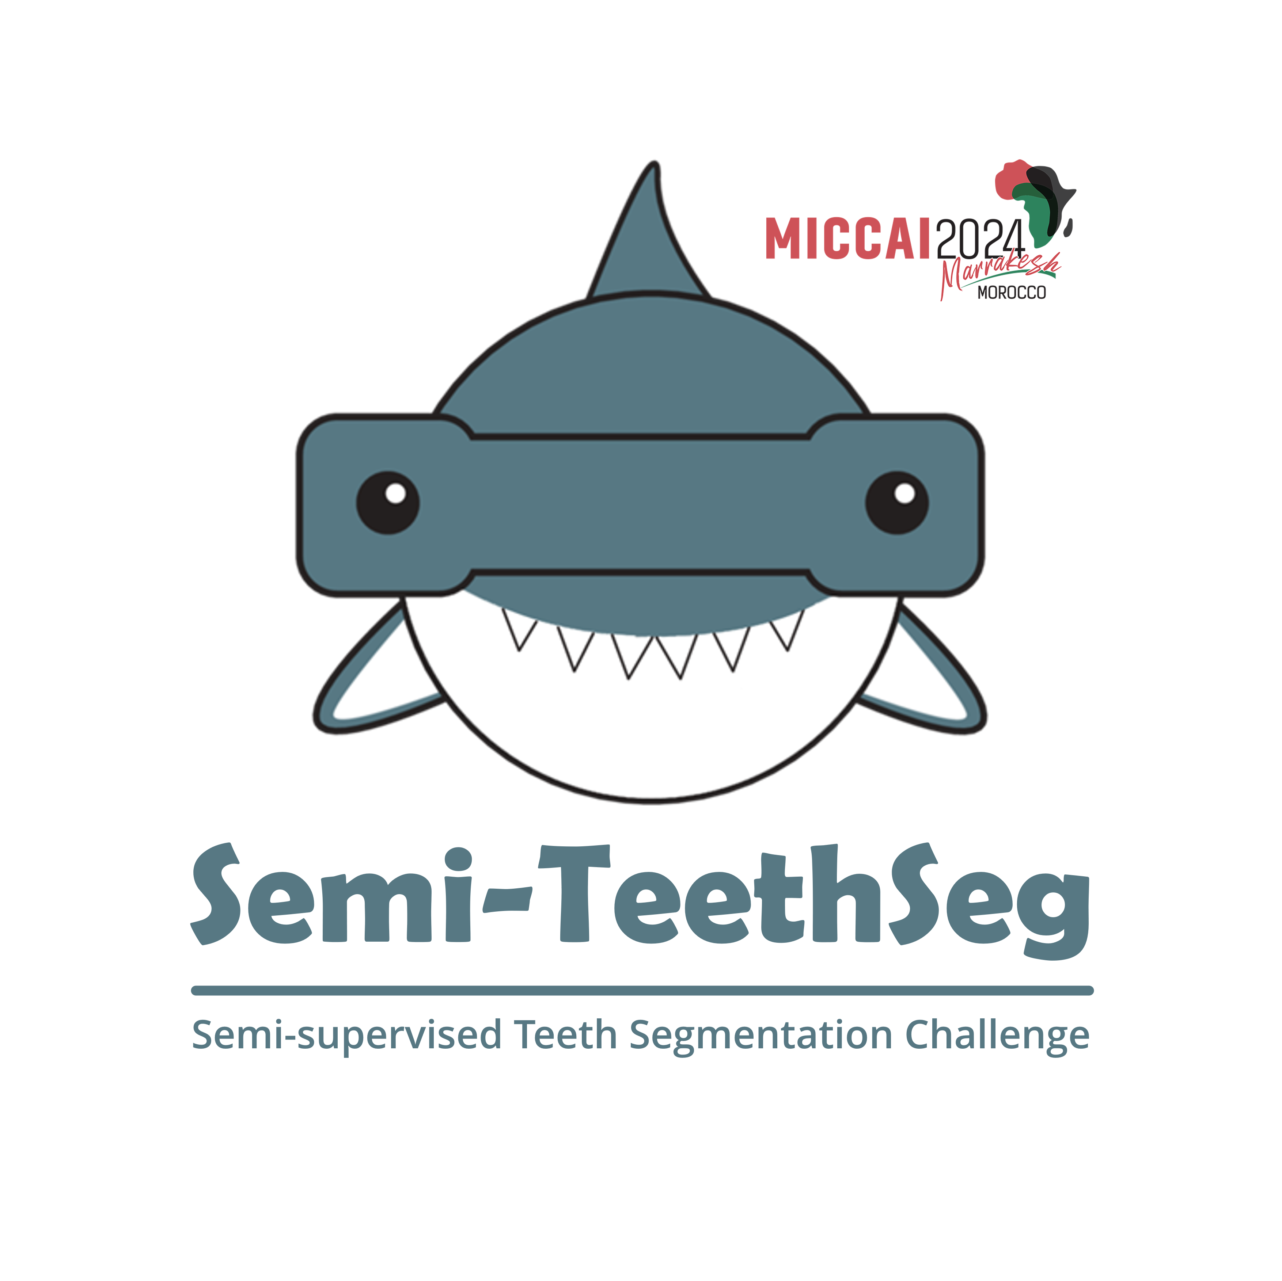
A Self-Training Pipeline for Semi-Supervised
2D Teeth Instance Segmentation
Team: camerart2024
Members: Kaiwen Fu, Chengyuan Chang, Qinjie Hu, Jiahui Chen
Supervisor: Fei Qi
Affiliation: Xidian University
2024/10/06
Notes:
Hello everyone! We are the camerart2024 team from Xidian University. We participated in the MICCAI-STS challenge and are thrilled to have secured second place. In this challenge, we proposed a self-training pipeline for semi-supervised 2D teeth instance segmentation. Now, we’d like to share our approach with you!

Slide 3
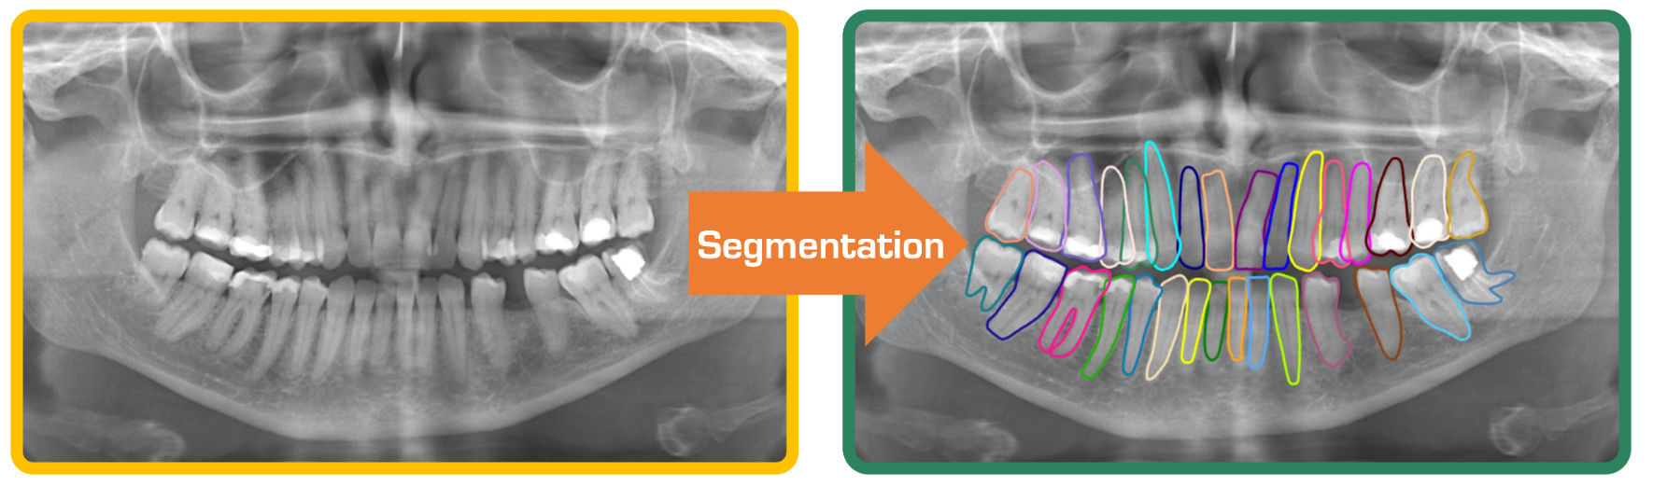
Background
The 2D panoramic X-ray image is an efficient ways for dentists to determine invisible caries, impacted teeth and supernumerary teeth among children.
Identifying teeth in panoramic X-ray images and manual annotation is time-consuming and labor-intensive, resulting in a limited availability of labeled data.
Semi-supervised learning provides a potential alternative for exploring useful information from unlabeled samples.
Notes:
First, let me give you a brief overview of the background of this challenge. The 2D panoramic X-ray image is a great tool for dentists to spot invisible caries, impacted teeth, and extra teeth in kids. However, identifying teeth in these X-ray images and manually annotating them is a slow and labor-intensive process. This often means we can't gather a lot of labeled cases, which really holds back the development of deep learning algorithms for teeth segmentation and disease analysis. That's where semi-supervised learning comes in as a promising alternative; it helps us make the most of the information we can get from unlabeled cases.

Slide 4
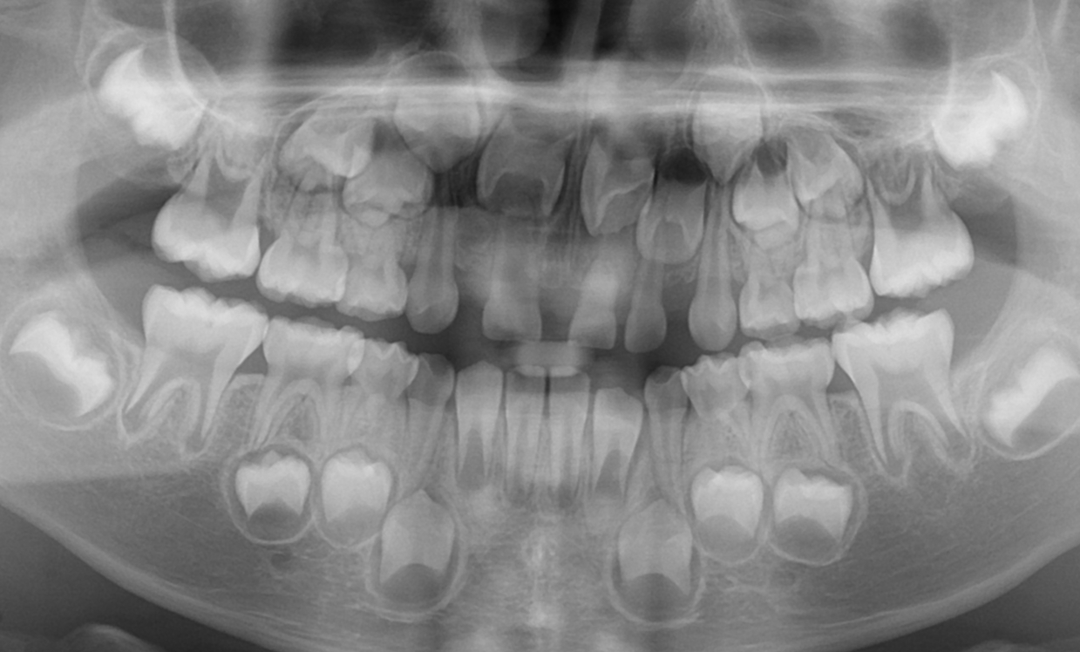
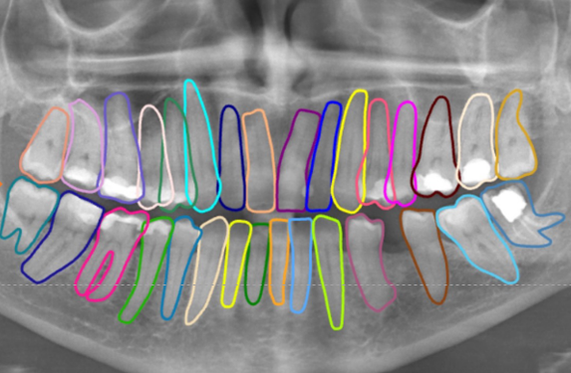
Problem analysis
The main challenges of the competition are as follows:
Very limited labled data
Excessive dental categories
Overlapping area
Unlabeled Data
Labeled
Data
×2,350
×30
Only 30 labled data are available
32 permanent teeth and 20 deciduous teeth
Many teeth overlap each other
Notes:
We see three main challenges in this competition. First, the available labeled data is really scarce—only thirty images—so the supervision for training our models is quite limited. Second, we need to segment and classify 32 types of permanent teeth and 20 types of baby teeth. With so many categories, and some being very similar, getting the classification right is pretty tough. Third, this is an instance segmentation task with overlapping areas between different teeth, which adds to the complexity. Current semi-supervised segmentation methods are mainly designed for semantic segmentation, making them hard to apply directly to instance segmentation. Plus, the overlapping areas make it challenging to use the softmax function to generate confidence scores for our segmentations.

Slide 5
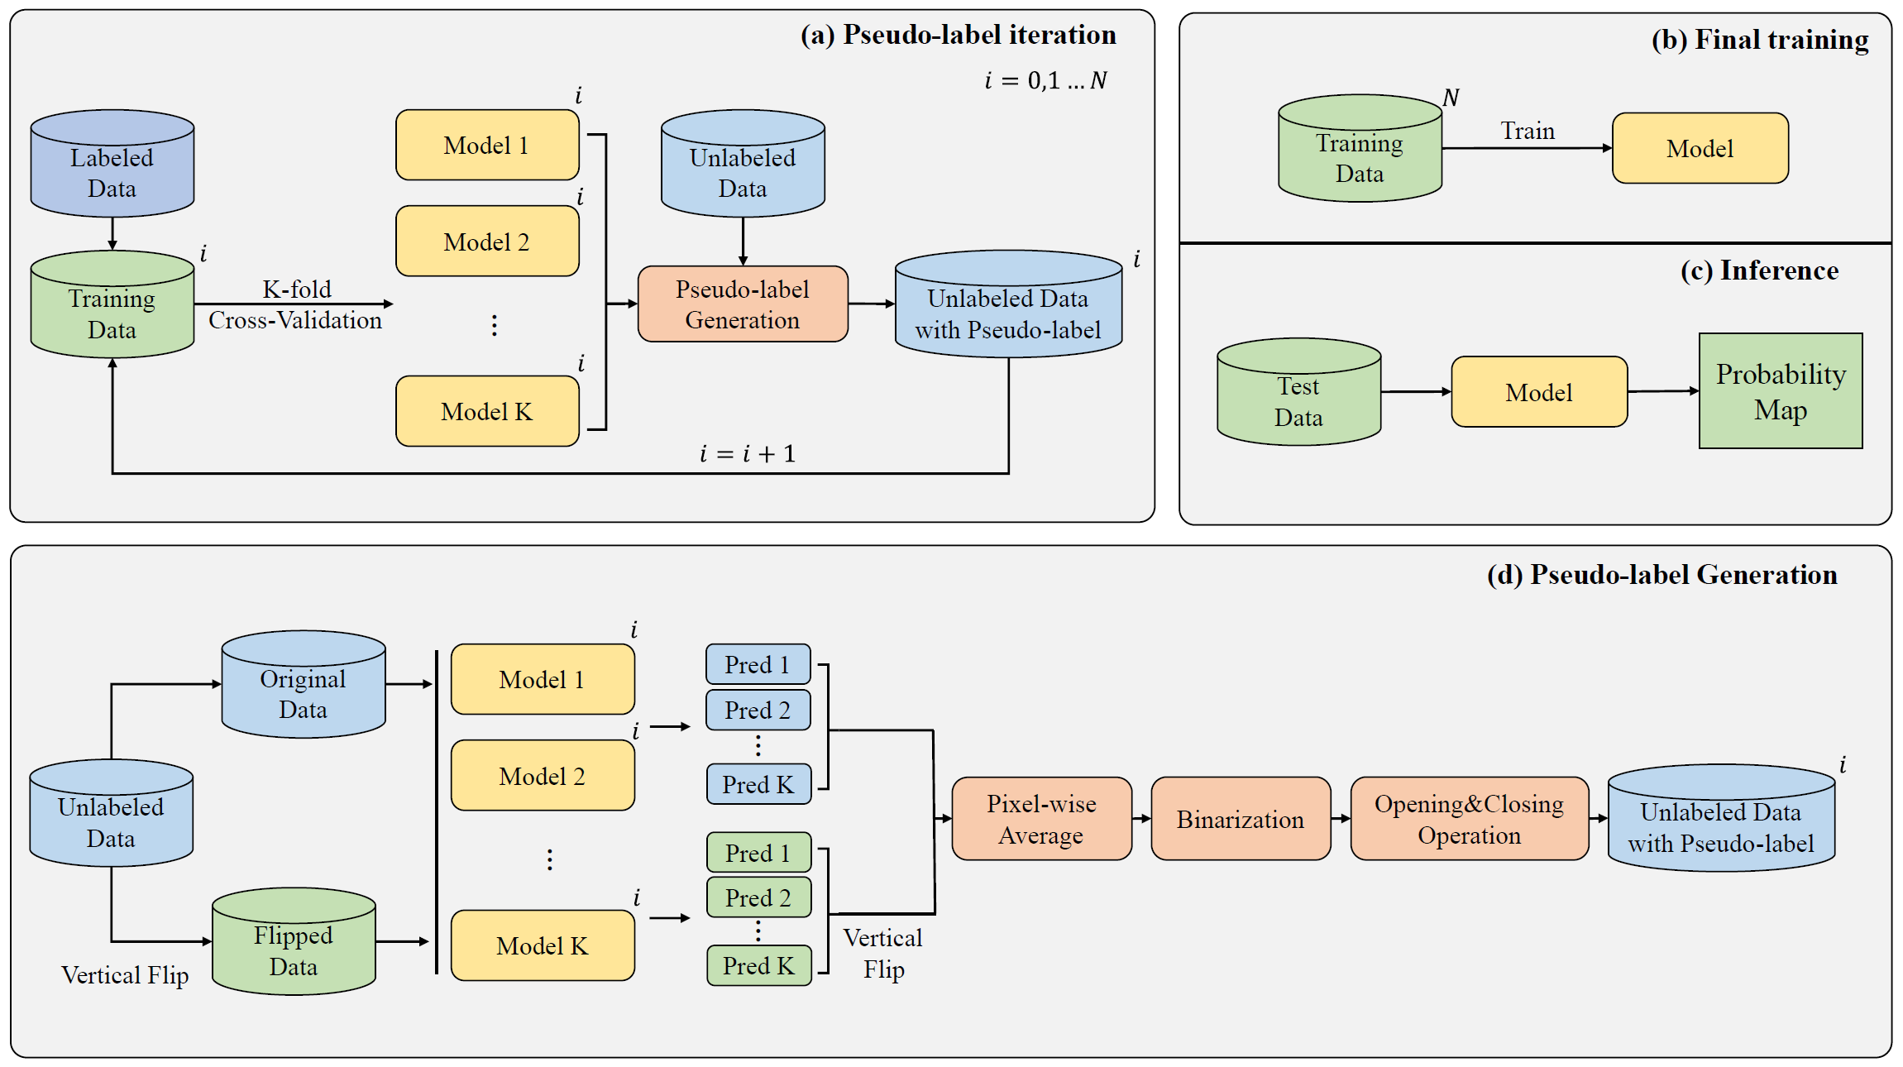
Self-Training pipeline
Notes:
To tackle these challenges, we proposed a self-training pipeline for semi-supervised 2D teeth instance segmentation. This pipeline mainly consists of three parts: generating and iterating pseudo-labels, final training, and inference. Next, I will go into the technical details of each part.

Slide 6
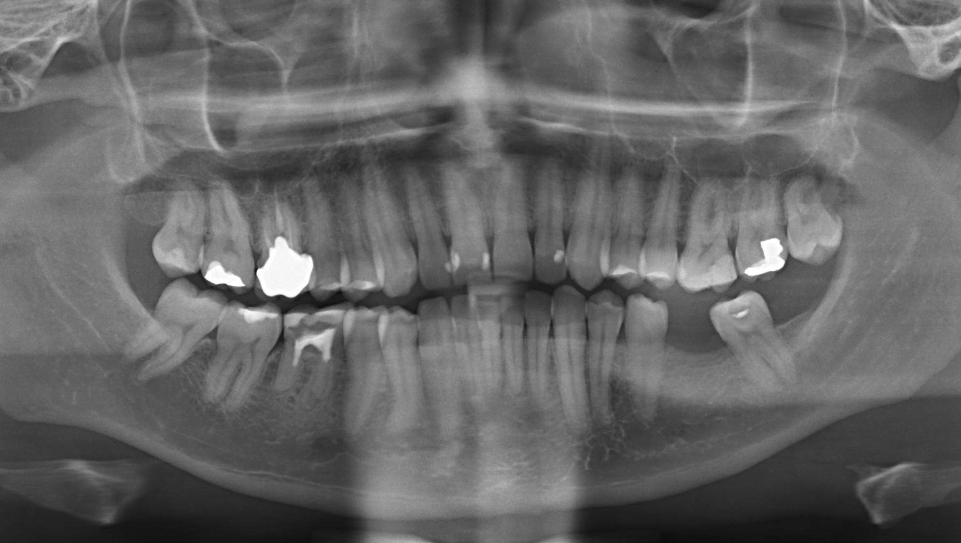
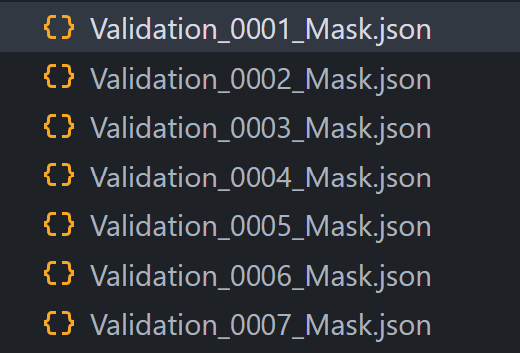
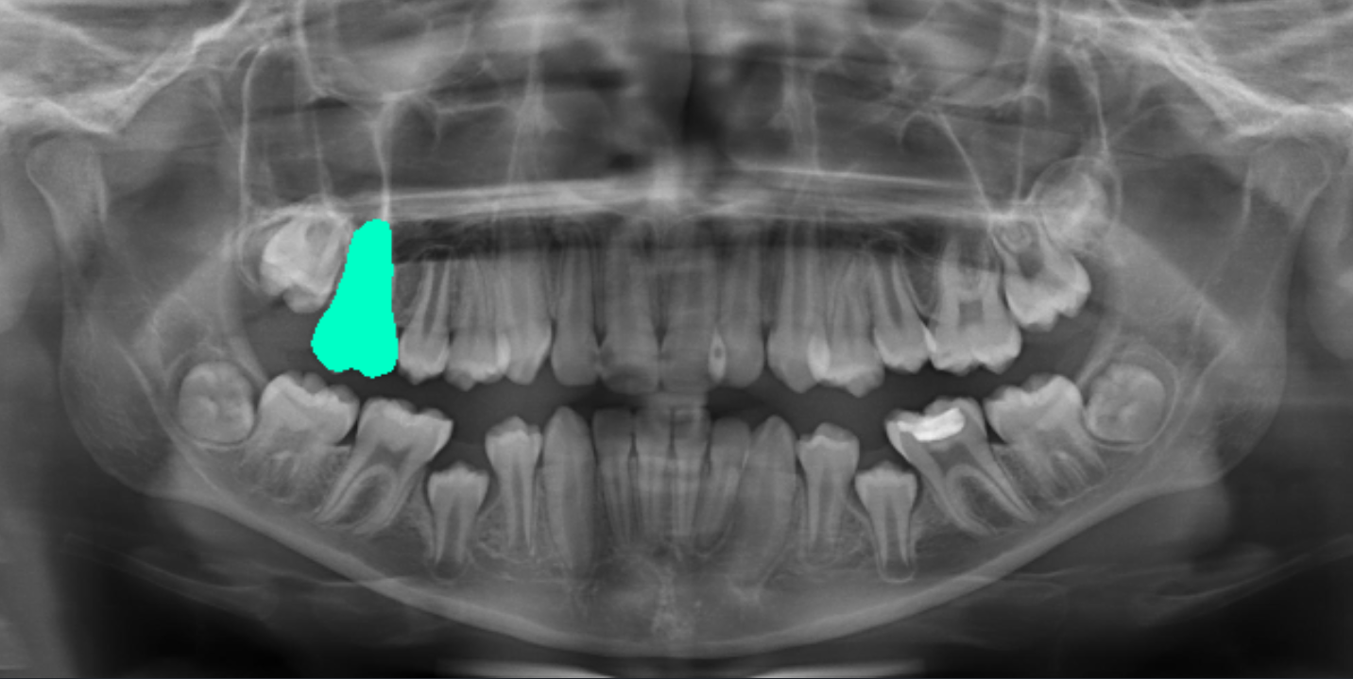
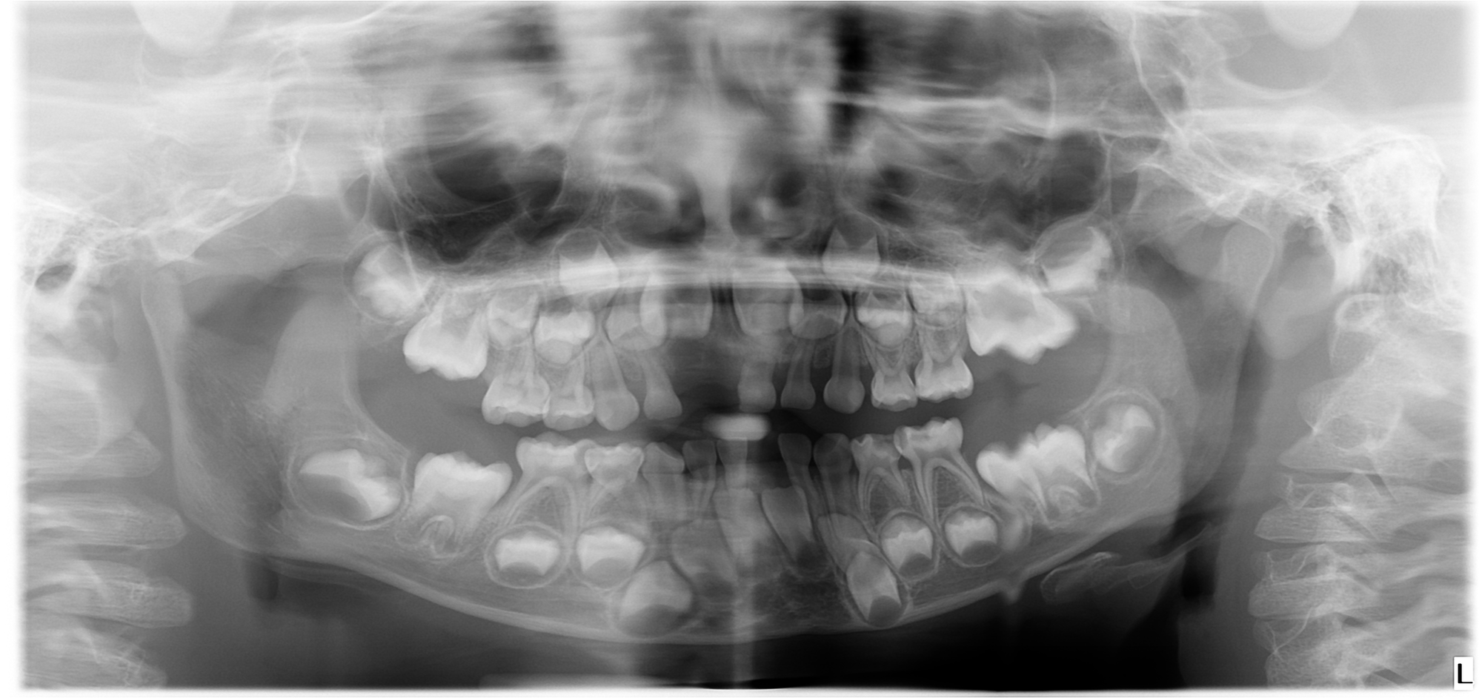
Preprocessing
Label format conversion
Resize
Resize
1127 × 1991
320 × 640
JSON
Ndarray(52 × H × W)
942 × 2000
Resize both the image and mask to 320x640 to reduce computational load and facilitate subsequent processing
Convert JSON to Ndarray mask, where each channel represents a specific type of tooth
Notes:
First, we need to preprocess the data. The labels provided for the competition are in JSON format, which can't be used directly for training. We convert them into a NumPy ndarray format with dimensions of 52xHxW. The converted labels have 52 channels, with each channel representing a specific type of tooth. This setup allows us to overcome the impact of overlapping areas, where the tooth regions are marked as 1 and other areas are marked as 0. The teeth in the dataset come from different hospitals, and due to variations in scanning equipment, the X-ray images have different resolutions: 1127x1991 and 942x2000. To facilitate training and further processing, we scale all images and their corresponding labels down to a resolution of 320x640. This reduction in resolution also decreases the computational load.

Slide 7
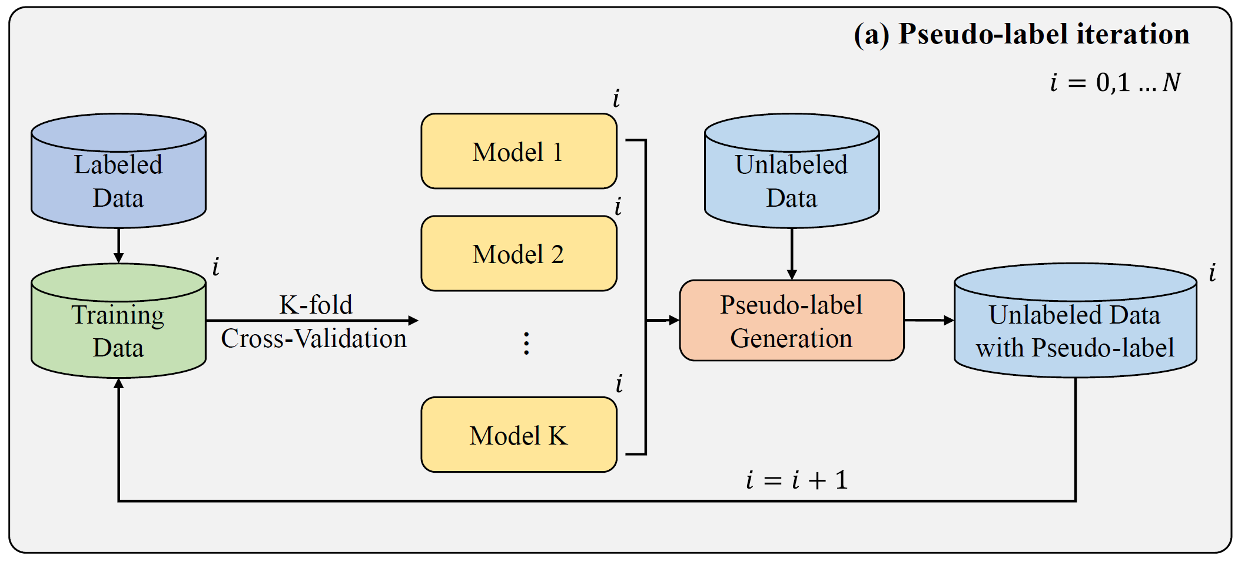
Pseudo-label generation and iteration
Train the initial models using only labeled data
Use initial models for pseudo-label generation on unlabeled data and add to training set
Re-train the models, update pseudo-labels, repeat N times
Notes:
Next, we’ll focus on the core of our method: pseudo-label generation and iteration. First, we train several models using only the labeled data to generate the initial pseudo-labels. Next, we add the unlabeled data along with the corresponding initial pseudo-labels to the training set and use this expanded dataset to train new models. Finally, we use the new models to iterate on the pseudo-labels, producing more reliable labels. This iterative process is repeated N times, during which the quality of the pseudo-labels continuously improves.

Slide 8
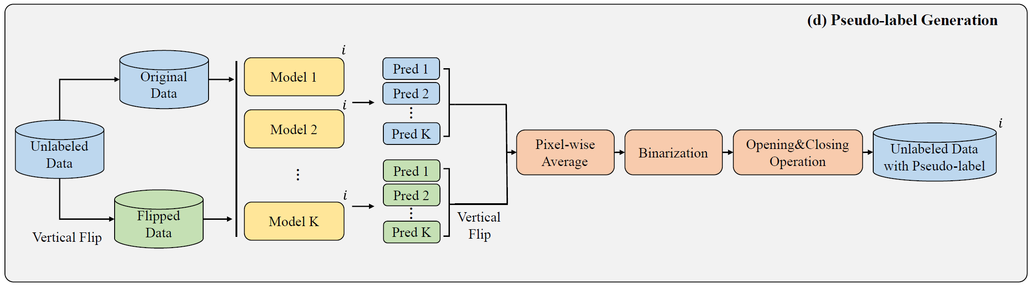
Pseudo-label generation strategy
We employed the following strategies to generate more reliable pseudo-labels:
Model ensemble: the inference result takes the mean of K model outputs (K=5)
Test-time augmentation: an image is inferred twice, the original image and the vertically flipped image
Morphological operation: remove small area noise using opening and closing operations
Notes:
In the pseudo-label generation process, we used a few tricks. First, we implemented model ensembling. Instead of training a single model with all the data, we used K-fold cross-validation to obtain K models, retaining only the one with the best Dice score from each fold. The inference results from the samples are averaged across the K models. This is a common trick in deep learning competitions to reduce prediction variance. Additionally, we used test-time data augmentation. Each image is inferred twice: once with the original image and once with the horizontally flipped version. The final prediction results are obtained by averaging the outputs from both runs. We also applied morphological operations to improve our predictions. We used opening to eliminate small false positives and closing to fill in small holes. These morphological operations helped further reduce noise in our predictions.

Slide 9
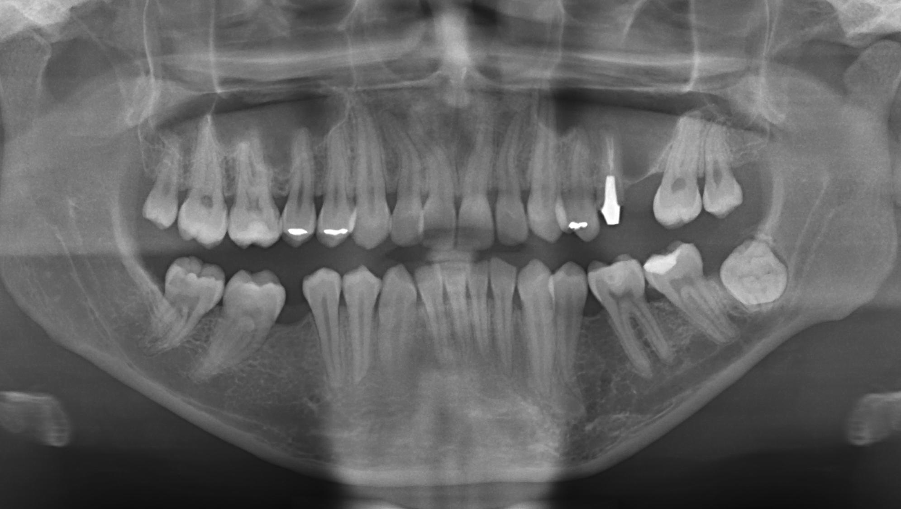
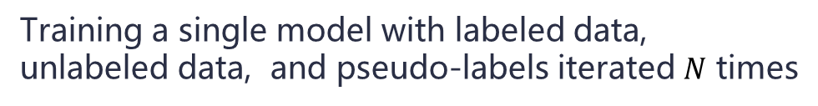
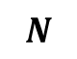
Final training & Inference
$$N$$
Unlabeled Data
Pseudo-labels
&
Train
Model
Avg.
Probability Map
Model
Labeled
Data
52 × 320 × 640
Vertical flip
Training a single model with labeled data, unlabeled data, and pseudo-labels iterated $N$ times
The same test-time augmentation is used in inference as in pseudo-label generation
Notes:
After iterating N times on the pseudo-labels, we trained a single model using the labeled data, unlabeled data, and the final pseudo-labels. After obtaining the final model, we can use it to infer the test images and generate the predicted probability maps. During the inference phase, we applied the same test-time data augmentation that we used for pseudo-label generation.

Slide 10
Post-processing
Probability Map
Resize
Probability
Map
Binarization
Original
Mask
cv2.findContours
channel by channel
52 × 320 × 640
52 × H × W
52 × H × W
JSON
Resize the image to its original size
Binarization with a threshold of 0.5
Find connected regions channel by channel using cv2.findContours
(PS: We exclude regions with contour points fewer than 45 to eliminate small area noise)
Remap channel numbering to tooth numbering
Notes:
After obtaining the probability maps, we need to apply post-processing to get the final prediction results. After obtaining the probability maps, we need to apply post-processing to get the final prediction results. First, since we downsampled the images to 320x640, the resulting probability maps were also downsampled, so we resize them back to their original size. Next, we binarize the probability maps using a threshold of 0.5. Then, we use the findContours function from OpenCV to find connected regions for each channel. To eliminate small false positives, we ignore connected regions with fewer than 45 contour points. Finally, we remap the channel numbering back to their corresponding tooth numbering. At this point, we have generated the predicted JSON file.

Slide 11
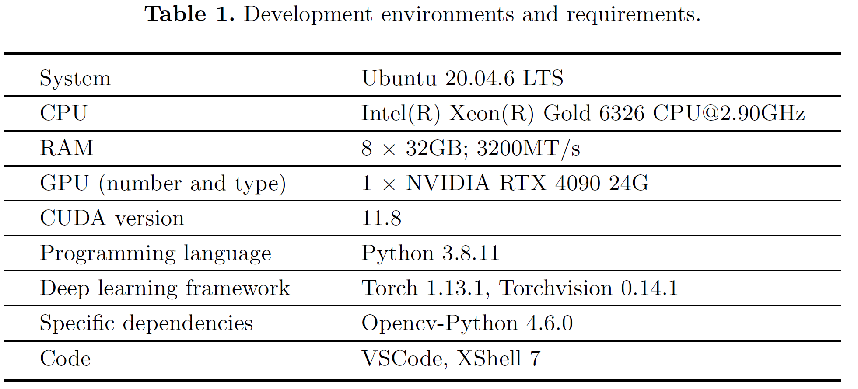
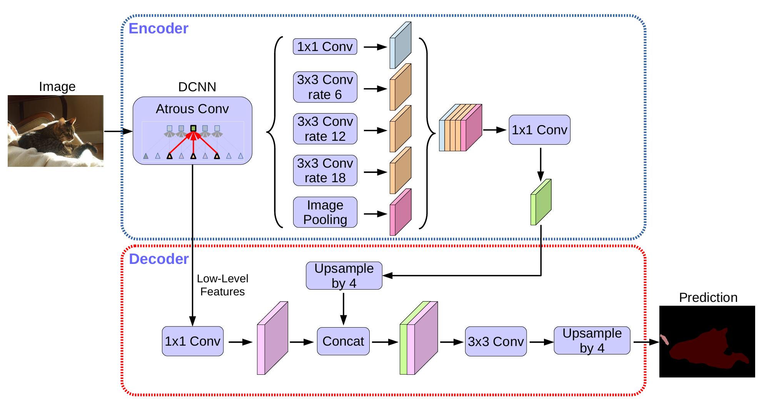
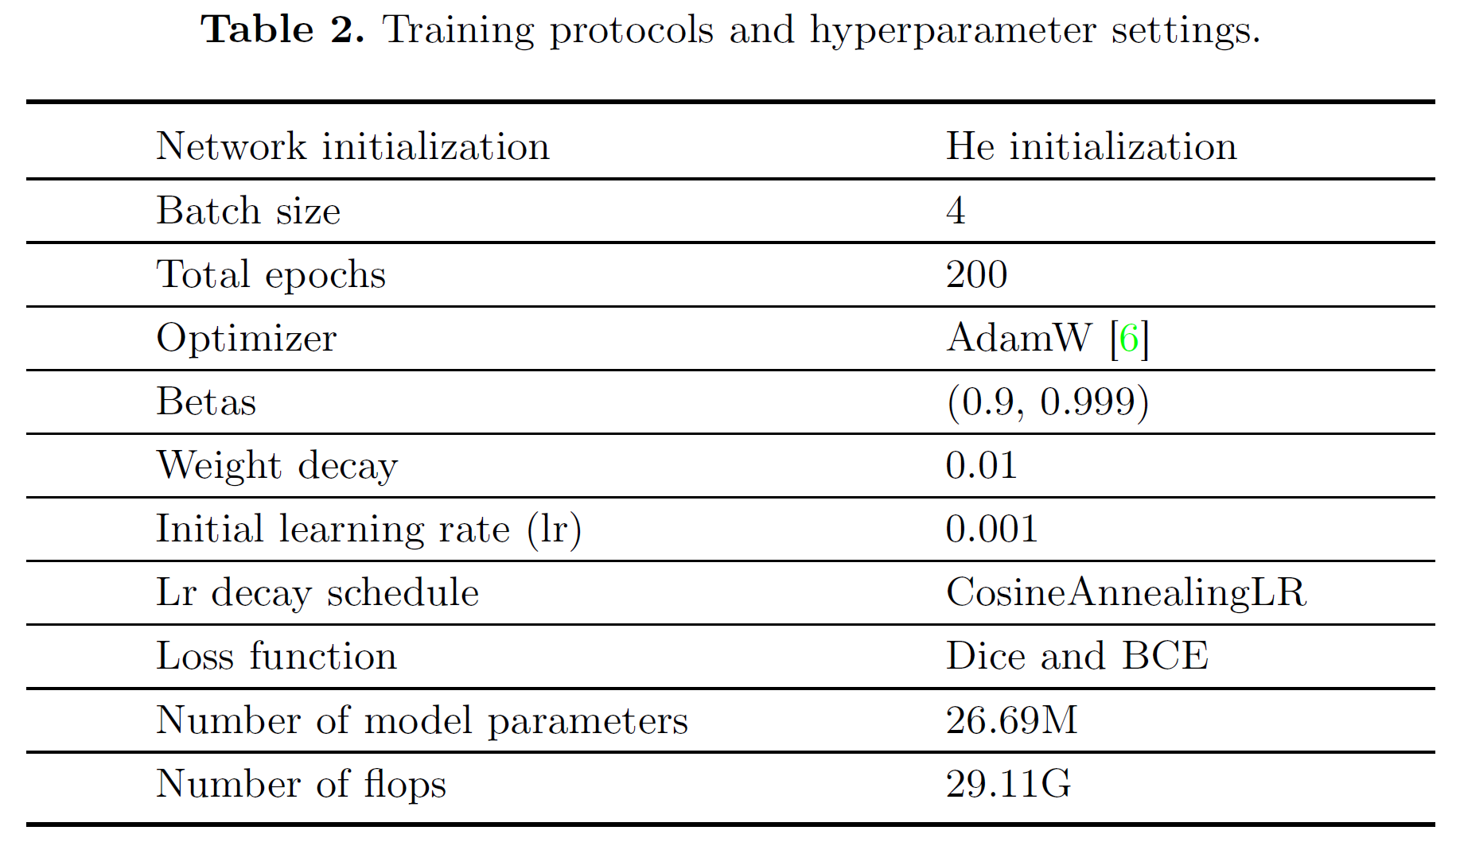
Implementation details
Segmentation model: DeepLabv3+ Backbone：ResNet50
3 × 320 × 640
52 × 320 × 640
Data augmentation used include:
Vertical flipping
Random gamma adjustment
Brightness and contrast enhancement
Blurring
Optical distortion
Elastic transformation
Grid distortion
Motion blur
Hue saturation adjustments.
For more details: https://github.com/Liaaaar/2024-MICCAI-STS-2D
Notes:
Next, let’s discuss some details about the equipment and training strategies we used. We employed DeepLabV3+ as our segmentation network, using ResNet50 as the backbone. Given the scarcity of labeled samples, we implemented extensive data augmentation to expand our training set. The augmentation techniques included vertical flipping, random gamma adjustment, brightness and contrast enhancement, blurring, optical distortion, elastic transformation, grid distortion, motion blur, and hue saturation adjustments. Our hyperparameter settings are outlined in Table 3. If you're interested in more technical details, you can directly browse our source code, which we have made open source.

Slide 12
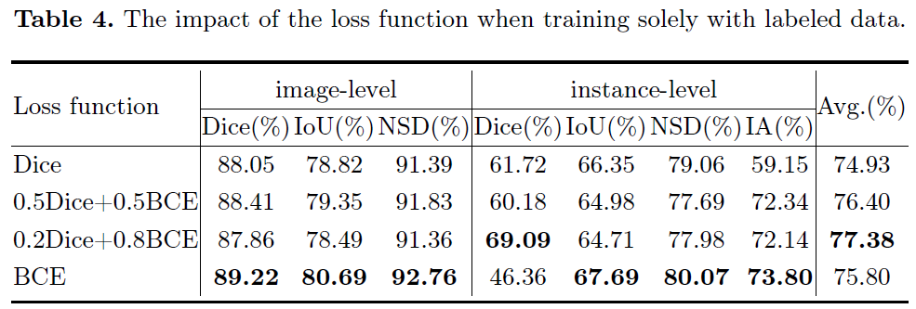
Loss function selection
We first experimented using only labeled data to determine the loss function during self-training
0.2 × dice loss + 0.8 × BCE loss performs the best
Notes:
Before starting self-training, we investigated the impact of the loss function and found that a combination of 0.2 times Dice loss and 0.8 times BCE loss worked best. This differs from the typical 0.6 to 0.4 ratio of Dice loss and BCE loss used in semantic segmentation. We applied this loss function in all subsequent experiments.

Slide 13
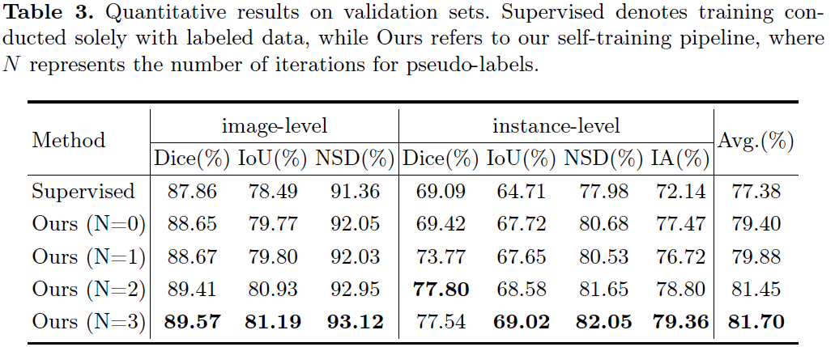
Quantitative results on validation set
Our self-training pipeline leverages information from unlabeled data to improve the model performance
As the number of pseudo-labels iteration increases, the performance of the model can be further improved
Notes:
These are the quantitative results on the validation set. With our self-training framework, we effectively utilized the information from unlabeled data. Even a simple one-time pseudo-label generation boosted the average score by 2.0 without requiring any iterations. Through continuous pseudo-label iteration, we gradually obtained more reliable labels. After three iterations, the average score increased to 81.7, and there was still an upward trend as the number of iterations increased. Among all the metrics, the largest improvement was in Identification Accuracy, which benefited from our pseudo-label iteration and generation strategy that effectively eliminated a significant amount of noise from the pseudo-labels. Additionally, we tested the inference speed of our method on the validation set. On an RTX 4090, the inference time for a single image was 0.161 seconds, which is adequate for real-time detection.

Slide 14
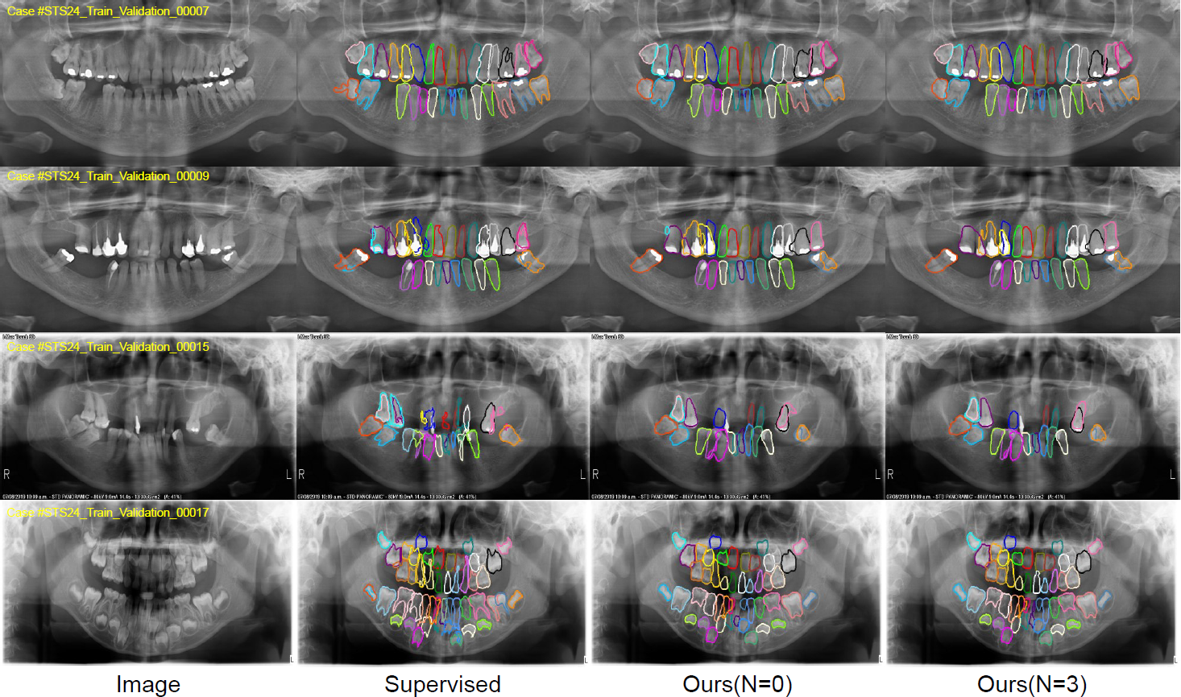
Qualitative results on validation set
Easy cases
Straight teeth
Many similar patterns in the training set
Hard cases
Misaligned teeth
Few similar patterns in the training set
Notes:
We visualized several cases to intuitively showcase the effectiveness of our method. For straight teeth teeth, our method demonstrates good segmentation performance. This is partly because the boundaries of these teeth are distinct and easier to segment, and also because the training set contains many similar patterns, allowing the model to learn effectively from them. For misaligned teeth, the segmentation difficulty is inherently higher, and there are fewer similar examples in the training set. This leads to a significant number of false detections and inaccurate segmentations by the model. Compared to models trained solely on labeled data, our model exhibits neater segmentation boundaries, reduced boundary noise, and a noticeable decrease in false detection areas. This indicates that we effectively leveraged information from unlabeled data, demonstrating the validity of our pipeline. However, our method does have certain limitations. For instance, in the root areas, we observe that our method tends to produce smooth segmentation contours and struggles to accurately segment sharp regions like the tooth roots, primarily due to the use of opening operations.

Slide 15
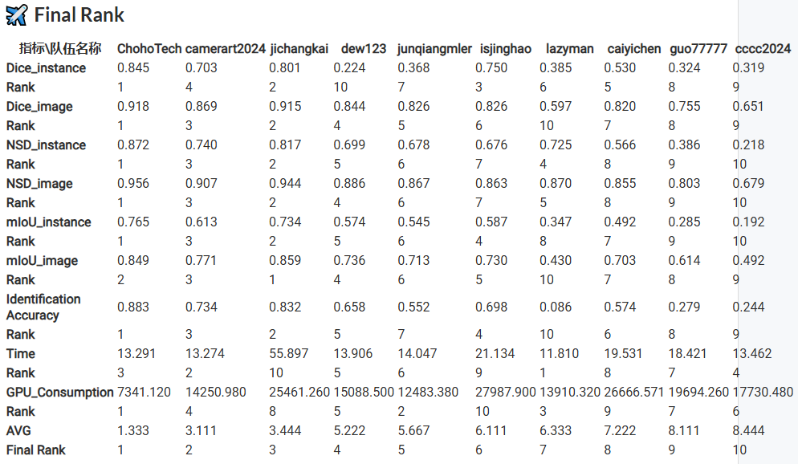
Results on testing set & Rank
Notes:
Lastly, here are the performances of different teams' methods on the test set. Our approach struck a good balance between performance and computational efficiency, allowing us to secure second place.

Slide 16
Thanks for listening!
https://github.com/Liaaaar/2024-MICCAI-STS-2D
Notes:
That‘s all we wanted to share today! Thanks so much for listening! We're really grateful to MICCAI for giving us this opportunity to connect. If you have any questions, feel free to open an issue on our GitHub!

